Slide 1

Project Presentation SE: Arschloch
Group 5: Ralph Segi, Jan Kaiser

Slide 2
Table of content
Organization:
Scrum
Git
TUI Development
GUI Development
MVC
Model/Controller Code Coverage
Localization
Design Patterns
Components & Interfaces
Dependency Injection

Slide 3
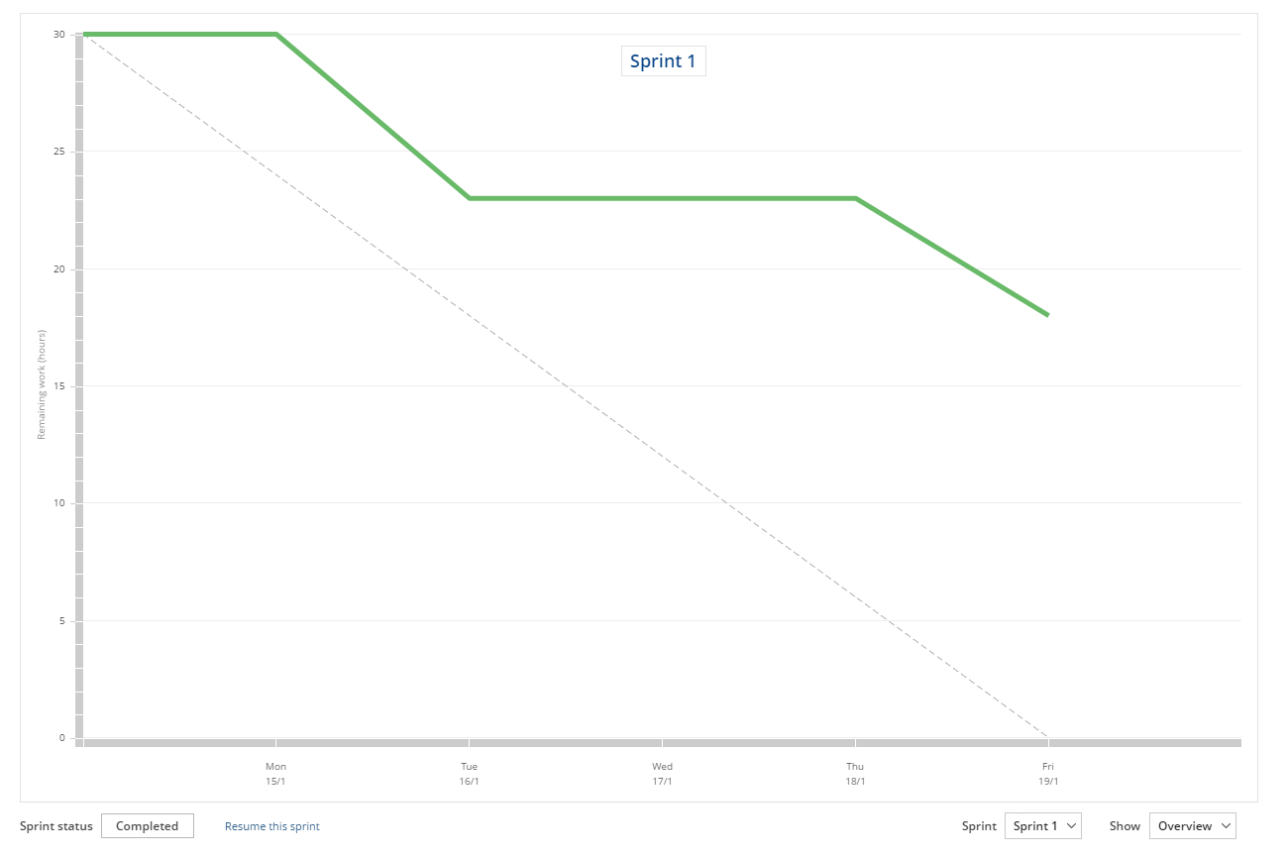
Scrum - Sprint 1

Slide 4
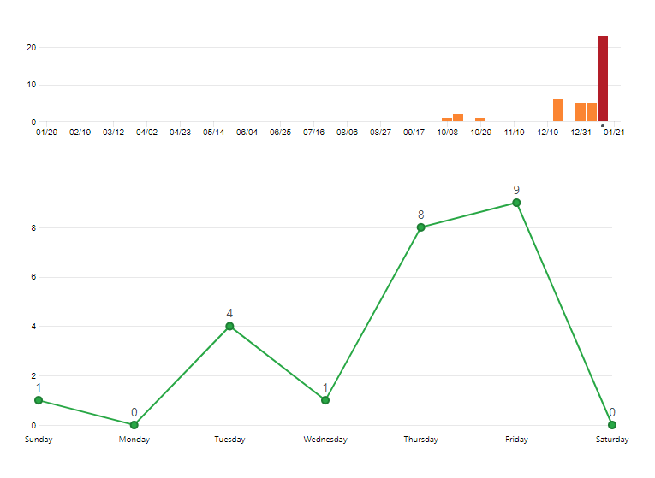
Git - Commits (Sprint 1)

Slide 5
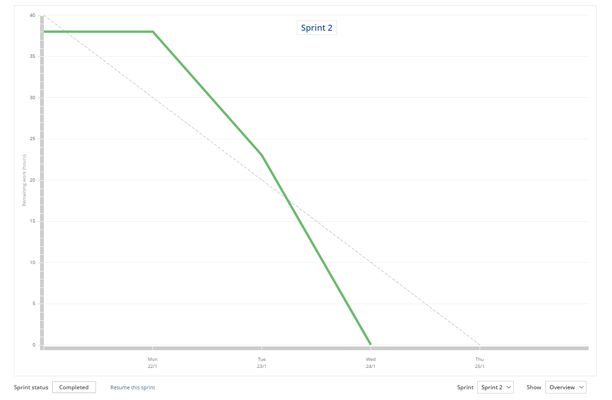
Scrum - Sprint 2

Slide 6
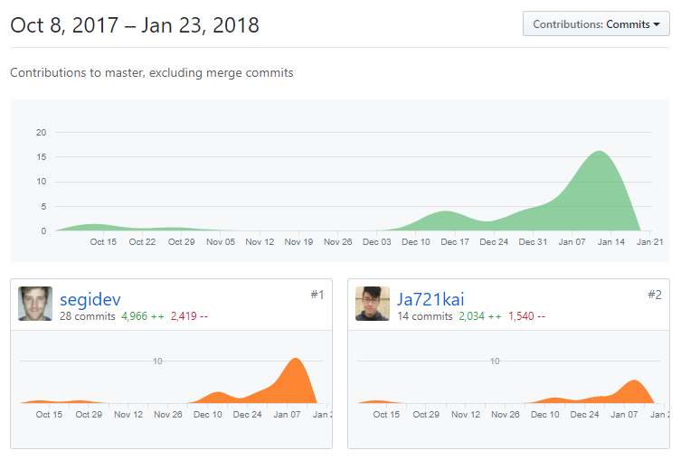
Git - Contributors

Slide 7
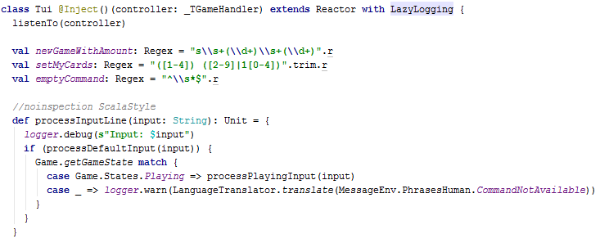
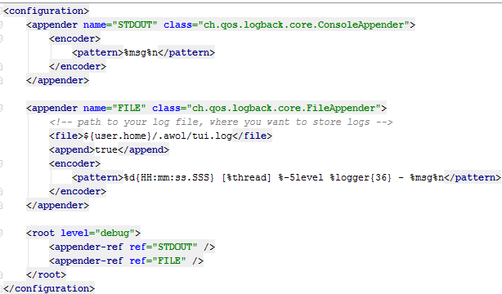
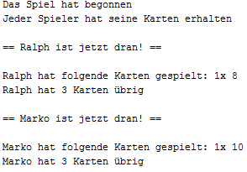
TUI Development
Injects the controller (our game handler)
Listens to the controller publisher
Affects also the GUI through the game handler
Uses backlog to write out to a file and the console (logback.xml example)

Slide 8
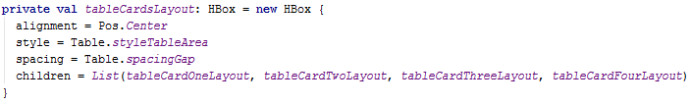

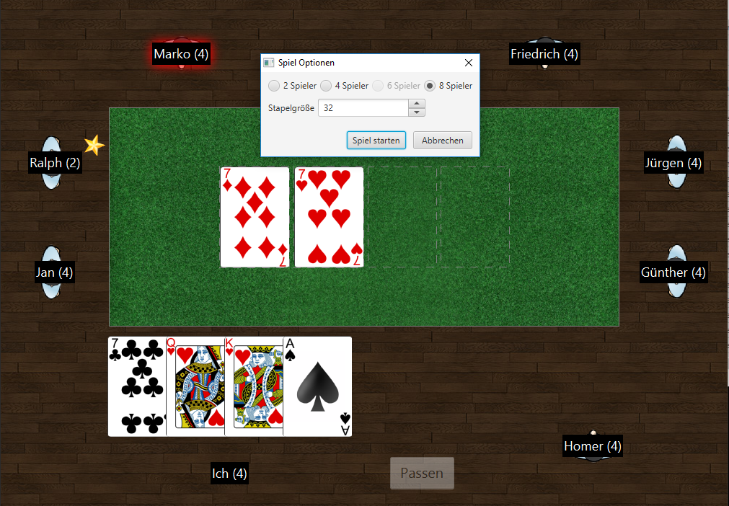
GUI Development
Uses ScalaFX (Panel) merged into a swing frame for non-blocking
Forced us to make sure methods run in the FX Application Thread
Affects TUI (obviously)
ScalaFX offers awesome Properties that can be bound like that: Something <== Property()

Slide 9
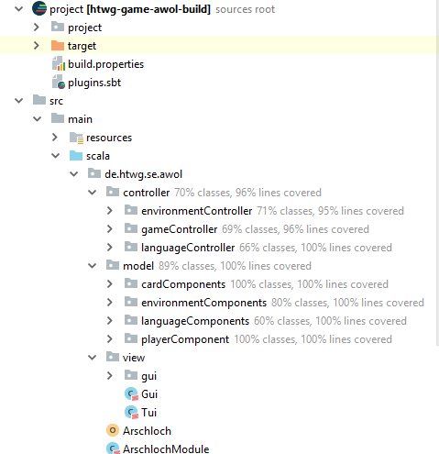
Model-View-Controller Architecture
environmentController:
Game Settings & JSON / XML
gameController:
controls game states
publish events
languageController:
controls translations for german/english
Model contains languages, card structure, deck structure, languages, messages, GUI images, player class
View contains GUI / TUI

Slide 10
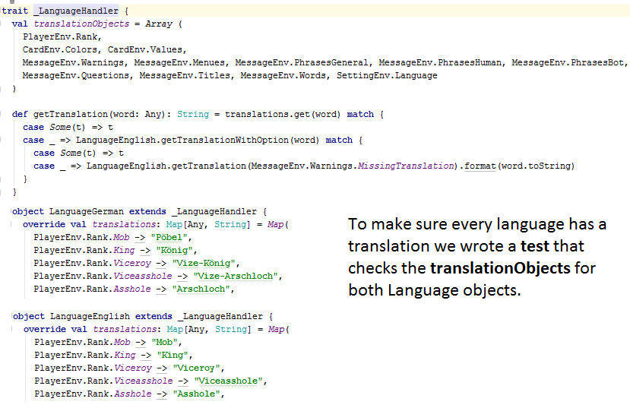
Localization
We created a trait that is inherited by every specific language we want to implement
Our LanguageTranslator object calls the getTranslation/getTranslationWithOption method
The LanguageTranslator holds a map with StringProperties that can be changed at runtime to translate the GUI (and every following message in the TUI/GUI) to the specific language

Slide 11
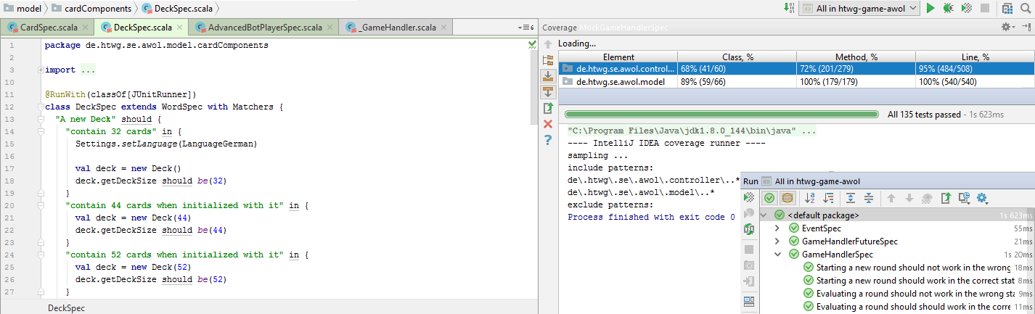
Code Coverage / Tests

Slide 12
Design Patterns
Observer
Singleton
Strategy

Slide 13
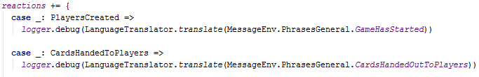

Observer Pattern
Observable
Observer
Uses scala.swing.Publisher to publish scala.swing.Event
Implemented in the game handler
Uses scala.swing.Reactor to receive scala.swing.Event
Implemented in the views (TUI and GUI)

Slide 14
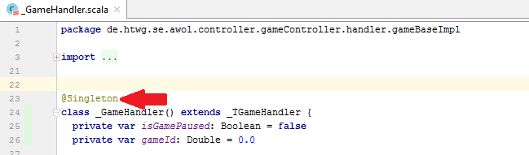
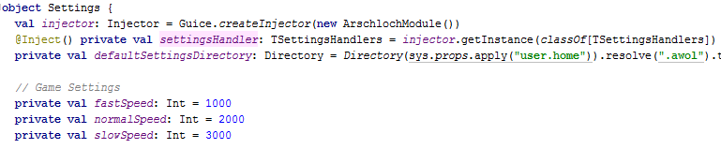
Singleton
Singleton through injection. @Singleton makes sure to inject only one instance to each „injector“
We also use Scala Objects to act as Singletons to handle e.g. our game settings

Slide 15
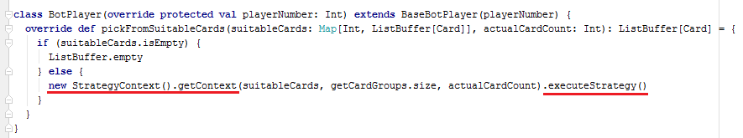
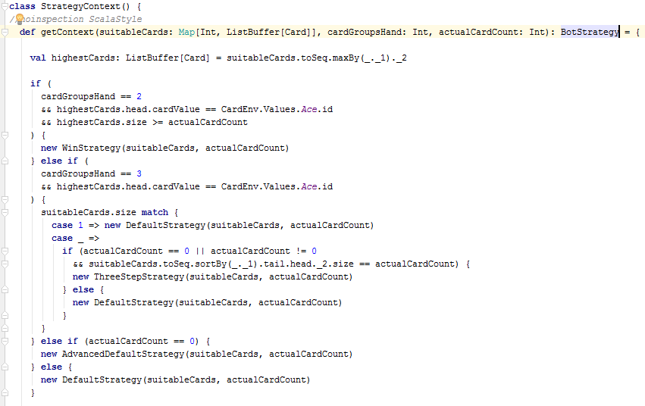
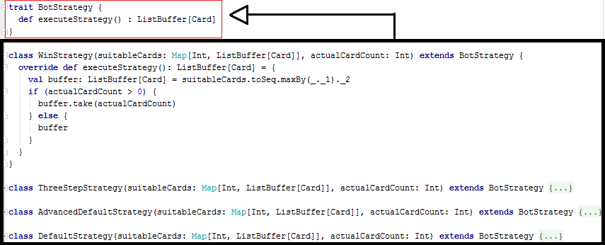
Strategy Pattern

Slide 16
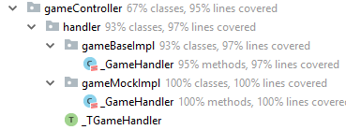
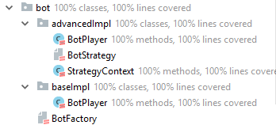
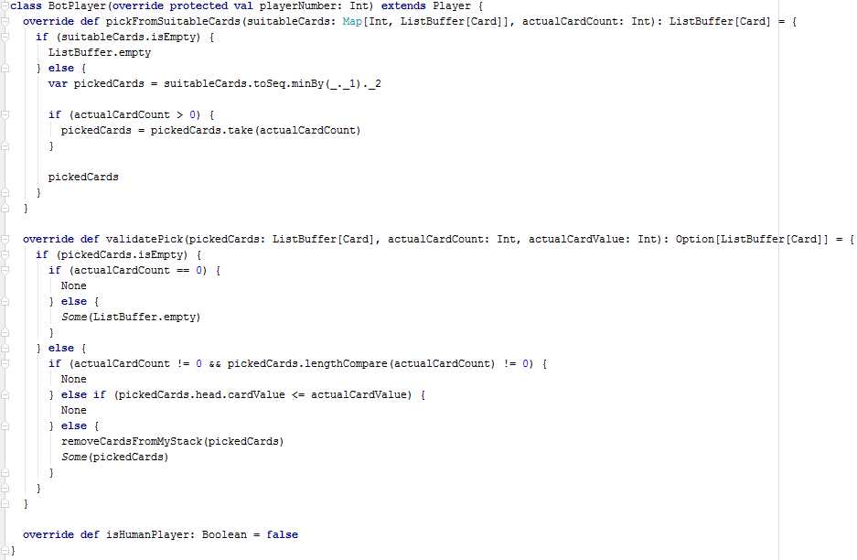
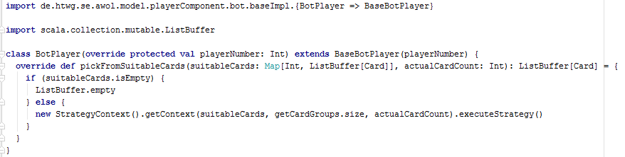
Components & Interfaces

Slide 17
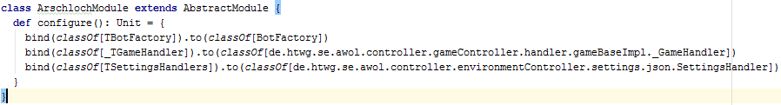
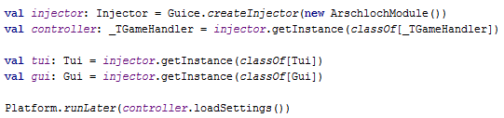
Dependency Injection
We define our Injection „manager“ with Google Guice
We dynamically load our gameHandler implementation which is injected into the TUI and GUI

